Slide 1
QualPro
Recommendations for
ACT Test Score Improvement
Student Version

Slide 2
We feel confident that any student that follows this program will increase their average ACT Scores by at least three points.

Slide 3
QualPro General Recommendations*
Learn key vocabulary words
Use better test-taking strategies for reading and science reasoning
Learn essential math concepts
Take at least four practice exams
* These recommendations should be accomplished during the junior year.

Slide 4
ACT Test Prep
Reading

Slide 5
Test-Taking Strategy for Reading
For reading the answers are in the test.
Spend one minute skimming the passages.
Go immediately to the questions and then quickly find the answers. DO NOT follow the ACT instructions which says to read the passages and then try to answer the questions.

Slide 6
ACT Test Prep
English

Slide 7
ACT Vocabulary — Words Required for English and Reading Tests* (Bare Minimum)
abstract
absurdity
acknowledge
acute
aesthetic
affluence
agenda
allegedly
ambiguity
ample
analogy
anomaly
apathy
arbitrary
articulate (v)
assert
assertion
authoritative
auxiliary
breadth
chaos
chronic
chronological
cite
coherence
coherent
collaborating
commendable
compellingly
concede
concise
concrete (adj)
condescension
confer
conformity
connote
consequence
consequently
consistent
contemporary (n)
context
controversial
conversely
convey
correlate (v,n)
cosmopolitan (adj)
counter (v)
criterion
cryptic
daunting
defiantly
definitive
delete
deletion
denote
derive
detached
deterrence
detract
dialect
dilemma
diligent
discern
disdainful
dispel
dissonance
distract
diverse
drawback
dry (humor)
eclectic
editorial (adj)
eloquent
eminent
emphatically
enumerate
escapist
establishment
evaluative
evoke
explanatory
explicit
extent
façade
facet
factual
faculty
feign
fictional
fictitious
figuratively
finding (n)
foresight
formality
format
frenzied
frivolous
furthermore
generalities
generalization
generalize
generate
genre
glib
humanitarian
hypothesis
idealistic
ideological
idiomatic
illogical
illustrative
imminent
implication
imply
impose
inaccurate
inadvertently
incentive
inclination
inconsistency
inconstant
indication
indifference
inevitable
inexplicably
infer
inference
influential
ingenious
ingenuous
inherent
initial (adj)
inquiry
insight
insignificant
insinuate
insistently
insufficient
intent
intently
interpretation
intolerant
intricacies
intricate
intrigue (v)
irreconcilable
irrelevant
irrevocable
likewise
longstanding
lyricism
mainstream
mandate (v)
matter of course
means (n)
mediocre
melancholy
mere
meticulous
minuscule
mischievous
misconception
momentous
mutual
narrative
nevertheless
nonetheless
nostalgia
noteworthy
notion
obscure (v)
obtuse
omission
omit
on behalf of
one-dimensional
onus
outset
paradox
parenthetical
perceptual
phenomenal
philosophy
plagiarism
populace
populous
portray
preceding
precisely
preconceived
previous
progressive
quasi-
quintessential
randomly
rational
redundancy
redundant
reinforce
relevant
reluctantly
remnant
remote
replenish
resemblance
resistant
resolution
resonate
resources
respectively
revel
reverent
revisionist
rift
rudimentary
sacrilege
sanctuary
sapling
satellite
saturation
scholarly
scrunity
scrutinize
seascape
seemingly
selectively
seminal
sensory
sentiment
serenity
shrill
shrub
shun
simultaneous
singular
site
sit-in
sizable
skepticism
slogan
social order
solace
sovereign
specific
speculate
spin-off
stable
stationary
stationery
status
steerage
stereotypical
stifle
subjective
succession
succumb
superficial
superimpose
sustenance
syndicated
syringe
taut
taxed with
tenet
terra firma
terrestrial
theorize
thereafter
thus
timber
tirade
toxin
trajectory
transcend
transition
translucent
treason
typesetting
tyranny
tyrant
uncanny
unparalleled
unprecedented
unsolicited
urgency
urn
vaccine
vindicate
visionary
vivid
voluptuous
vulnerable
wherefore
whimsy
withdrawn
worldview
* All these words taken from the five practice tests in the real ACT Prep Guide, 3rd Ed. These are words that the students are REQUIRED to know just to process the answers

Slide 8
ACT Vocabulary Words Required for
English and Reading Tests—Bare Minimum—Comprehensive List
abstract adj—not like anything physical; not representing a physical object; related to
thought or imagination as opposed to nature. Opposite of concrete.
The two-year-old’s finger painting looked more like abstract art than a picture of a cow.
absurdity n—the state of being ridiculously impossible
Expecting Charles Barker, the retired basketball player, to wear a pink sequined tutu and
walk a tight wire strikes me as the height of absurdity.
acknowledge vt—to admit to be true
Myra acknowledged that the grapes in the refrigerator would be colder than the ones
on the counter.
acute adj—
1. in geometry, less that 90° and therefore pointed and sharp; keen
My Uncle Theo has an acute sense of humor.
2. immediate and in need of attention; said of a disease. Opposite of chronic
Paul was rushed to the hospital for an acute appendix attack.
aesthetic
adj—artsy; related to beauty or excellence
Japanese food is usually more aesthetic than Granny’s home cooking.
n—a standard for judging something’s goodness
The judge’s aesthetic for rating the divers included the height of the splash as well as
the straightness of the divers’ legs.
affluence n—wealth
Most Americans do not appreciate their affluence when compared to the rest of the
world.
agenda n—plan of accomplishments and the time needed to perform them
I did not have “stop at Bruster’s for ice cream” on my agenda, but I’m glad to add it.

Slide 9
ACT Vocabulary Words (continued)
allegedly adv—according to what people say but unproven
By the time you read this, the scandalous things people have allegedly done today will
either be proved or disproved.
ambiguity n—ability to be understood in either of two ways
The Kinks’ song “Lola” was famous for its ambiguity: “I know I’m not the most masculine
man,/ But I know what I am, and I’m glad I’m a man / And so’s Lola.”
ample adj—adequate; plentiful; abundant
If the pants are too short, there is ample fabric in the hem to lengthen them.
analogy n—comparison; a way to show how one thing is like another
Calling Cruella DeVille’s heart as cold and hard as a diamond is a good analogy.
anomaly n—something that doesn’t fit or belong and can’t be explained
The doctor was worried about an anomaly in Granny’s heart rhythm.
apathy n—lack of feeling
My little brother had nothing but apathy for the socks he got for Christmas.
arbitrary adj—chosen at random; having no pattern
After trying to follow Pia’s singing, Chuck gave up and started playing arbitrary chords.
articulate v—to say something clearly and in detail
Ms. Hall articulated to the noisy class that even a sigh would cause them to miss recess.
assert vi—to state strongly
Aunt June asserted that her peach pie always won the prizes at the fair.
assertion n—a statement made strongly
When Mike ate his pencil eraser, I believed his assertion that he was hungry.
authoritative adj—confident; sounding as if an expert had said it
Anything Dolly Parton says about wigs is considered authoritative advice.
auxiliary adj – additional; used as a substitute in case of need
Our home has an auxiliary power source in case we lose electrical service.
breadth n—width, wide range or extent
During the debate, the challenger demonstrated his breadth of experience
in foreign affairs.
© 2012 QualPro

Slide 10
ACT Vocabulary Words (continued)
chaos n—complete confusion or disorder
The chaos that occurred after the hurricane included young men overturning vehicles,
rioting, and looting.
chronic adj—ongoing; across time. Opposite of acute
Because my sister suffers from chronic headaches, she had to give up soccer.
chronological adj—arranged in date or time order
Jacob’s diary provided a chronological account of his life.
cite v—to show the source of
My teacher makes us cite all our sources when we write a research paper.
➔Note: do not confuse with site
coherence n— logical connection and clearness
Dr. Hackney’s coherence on the witness stand caused the jury to believe her testimony.
coherent adj—logically connected
My English teacher insists that a paragraph must include a good topic sentence and
several coherent supporting sentences.
collaborating vi—to work together with
The music, dance, and art departments are collaborating with the drama department to
produce Oklahoma.
commendable adj—worthy of praise
We want to thank the art department, whose commendable work made our stage look
like a wide-open prairie.
compellingly adv—in a manner that causes someone to consider believing
Because Joan presented her argument so compellingly, Mom let her go on spring break.
concede vt—to admit
Although the race was close, the losing candidate conceded defeat just before midnight.
concise adj—efficient with words; saying what needs to be said in as few words as possible.
Being concise makes sense when sending a telegram that charges by the word.
© 2012 QualPro

Slide 11
ACT Vocabulary Words (continued)
concrete adj—looking like something physical; representing a physical object; related to
nature, as opposed to thought or imagination. Opposite of abstract.
Most people believe concrete evidence more than they believe gossip.
condescension n—the act of lowering oneself to do something considered too “low”
The movie star acted with condescension to her old school chums, who had known her
when she was a second-string basketball player.
confer vi—to talk with on a particular subject
After the coach conferred with the referee, he took Calvin out of the game.
conformity n—the act of going along with what everybody else is doing
The rule at my school is conformity for the first three years, then everyone dresses
as they please.
connote vt—to cause to think about, as opposed to plainly stating. Opposite of denote.
To many people, country music connotes cowboy boots, glittery clothes, and twangy voices.
consequence n—result; what follows due to something that went before
The consequence of going overboard with your credit card is a mountain of debts.
consequently adv—as a result
We have had little rain this summer; consequently, many crops are drying up.
consistent adj—
1. the same throughout; fair
Old Man Turner is mean, but at least he’s consistent; he yells at everybody.
2. in harmony; having the same principles
The kids’ new club rules are consistent with the Constitution.
contemporary n—someone who lived at the same time
Napoleon and Jane Austen were contemporaries, but I don’t think they ever met.
context n—the sentence that surround the words
Depending on the context, a “run” may be a point in baseball or a tear in a woman’s
stocking.
controversial adj—causing much discussion or scandal
Letting eighteen-year-old soldiers drink alcohol is still controversial; they can give their
lives for their country, but they can’t buy a drink to celebrate a victory.
© 2012 QualPro

Slide 12
ACT Vocabulary Words (continued)
conversely adv—in the opposite order
Mom always puts milk first, then butter, then eggs in the refrigerator; conversely, she
always removes eggs first, then butter, then milk.
convey vt—to make known; to serve as a means of communication
By his tears, DeShawn conveyed that the movie touched his heart.
correlate vt—to show how one thing relates to another
My favorite teacher can correlate what students like with what they need to learn.
cosmopolitan adj—worldly; educated in the ways of the world
Adding options like salsa, guacamole, and mushrooms gave Uncle Larry’s hot dog stand a
cosmopolitan air.
counter vt—to oppose in response
When my brother said I didn’t know everything, I countered with, “Neither do you!”
criterion n—a standard or reason for judgment.
Bubba’s criterion for a good car is a teeth-rattling sound system, but Brad’s criteria are
good mileage, rapid acceleration, and a color that matches his eyes.
➔Note: the plural is criteria.
cryptic adj—with a hidden meaning (its root word is crypt, meaning “hiding place”)
Because Beth always gives me a cryptic answer, I’m never sure what she wants.
daunting adj—big or scary enough to make a person think twice before going ahead
Nichole had a daunting amount of homework, but she finished it before 9:00.
defiantly adv—with an oppositional attitude.
Patrick Henry defiantly said, “Give me liberty or give me death.”
➔Note: do not confuse with definitely.
definitive adj—
1. the qualities that make something what it is
The quarterback’s definitive coordination earned him a full scholarship.
2. the most nearly complete and accurate
In Myra’s family, her mother’s rules are the definitive rules.
➔Note: do not confuse with definite.
© 2012 QualPro

Slide 13
ACT Vocabulary Words (continued)
delete vt—to take out; remove (said of words)
To make sure the handout of the Pledge of Allegiance was perfect, Gilda told Fred to
delete “Richard Stands” and write “which it stands” instead.
deletion n—the act of marking something out
The boss made so many deletions that it would have been easier for me to start over.
denote vt—to state plainly; to give an exact meaning. Opposite of connote.
The “six-pack” my sister’s computer date bragged about was actually what it denoted—
a half-dozen cans of Pepsi, not a muscular abdomen!
derive vt—to arrive at by computing or thinking
My big sister derives a lot of pleasure from watching my brother and me arguing.
deterrence n—something that keeps people from doing something
All those thorns provide deterrence against the theft of Mrs. Lorrimer’s prize roses.
detached adj—neither on one side nor the other; objective; without bias; not “attached” to
one side of an argument
The policeman’s detached attitude made me believe he was listening to me fairly.
deterrence n—something that keeps people from doing something
All those thorns provide deterrence against the theft of Mrs. Lorrimer’s prize roses.
detract vi—to reduce the quality of
Jeremy’s handprints in the frosting detract from the eye appeal of his birthday cake.
dialect n—a form of language used by people of a certain region or group
Having always lived in East Tennessee, Ashley understood the dialect of the South.
dilemma n—a choice between two confusing alternatives
Madison was faced with the dilemma of losing sleep to study for the test or getting
eight hours’ sleep but not reading the last two chapters.
diligent adj—hard-working
It wasn’t so much being smart as it was being diligent that earned Steve his first million.
discern vt—to recognize as separate or different
A smart daughter will discern her mother’s mood before she asks to stay out late.
© 2012 QualPro

Slide 14
ACT Vocabulary Words (continued)
disdainful adj—showing lack of respect
The student’s disdainful behavior caused the entire class to miss recess.
dispel vt—to get rid of
Harold’s performance in his latest movie dispelled the rumors that his success is due to his famous father.
dissonance n—unmatched, disturbing sounds; lack of harmony
There is too much dissonance between Butch’s Butcher Shop and Veronica’s Vegan Deli
for them to share a courtyard.
distract vt—to draw attention away
Listening to hip hop while I study distracts me from my French homework.
diverse adj—having parts that are unlike each other
The Mortons have diverse pets: a hermit crab, a Great Dane, and a chicken.
drawback n—disadvantage of doing something; reason not to do something
One big drawback to being a medical examiner is the smell of the dead bodies.
dry adj—reserved and subtle, as opposed to broad and obvious (said of a sense of humor)
Steven Wright’s dry humor leads him to write jokes like, “Right now I'm having amnesia and déjà vu at the same time. I think I've forgotten this before.”
eclectic adj—having components from a wide variety of sources
Maeve’s new living room is an eclectic mix of Louis XIV furniture, Disney character
posters, and lamps made from cowboy spurs, saddles, and ropes.
editorial adj—having the qualities an editor might add, as opposed to fact-based news stories
Mr. Franklin’s editorial comments made it clear that his newspaper would not be
supporting Taft in the fall.
eloquent adj—graceful and skillful of speech
The committee chose Thomas Jefferson to write the Declaration of independence
because he had written so many eloquent letters and proposals before.
eminent adj—famous; outstanding
The eminent surgeon, Dr. Phillip Easterly, spoke at my sister’s graduation.
➔Note: often confused with imminent
© 2012 QualPro

Slide 15
ACT Vocabulary Words (continued)
emphatically adv—with great emphasis
When the waiter asked Ted if he wanted anchovies, Ted emphatically said, “No!”
enumerate vt—to count out one by one
Carl enumerated Melissa’s charms: her eyes, her figure, and her quiet sense of humor.
escapist adj—literature or art that rejects the routine of the real world
Arliss and Ethan prefer escapist video games with dragons and wizards to playing ball.
establishment n—“The powers that be”—those who by their wealth or power make the
social rules
The hippies rebelled against the Establishment by wearing long hair and blue jeans.
evaluative adj—helping to judge
The news is not supposed to be evaluative; it’s supposed to give information so that the
viewers can make up their own minds.
evoke vt—to bring to the mind or the senses
The smell of hot buttered popcorn always evokes a dark theatre and a new movie.
explanatory adj—explaining; giving details about something in order to make it easier to
understand
The recipe made more sense when Madison read the explanatory notes at the bottom.
explicit adj—obvious and detailed
The crime scene show was too explicit to watch while we were eating pizza.
extent n—a place as far as
People appreciate how hard people work for them only to the extent that they have
done the job themselves.
façade n—false face; front; shallow covering of the real thing
Driving a fancy car was part of the façade that hid how poor he really was.
facet n—a particular side, as of a jewel; aspect
When Nat saw the photo of “The Pirates of Penzance” in his father’s yearbook, he
appreciated a new facet of his father’s personality.
factual adj—based on proven knowledge
The skid marks provided factual evidence that the driver had tried to stop.
© 2012 QualPro

Slide 16
ACT Vocabulary Words (continued)
faculty n—individual parts that make up a whole person or institution
The school’s faculty, every single one of the teachers, reminded Tommy of the faculties
he had left after his blindness: memory, imagination, sense of humor, intelligence,
and understanding.
feign vt—to pretend; to fake
Steve feigned sleep so his mother would leave him alone.
fictional adj—made up, as opposed to factual
The Wizard of Oz is a fictional character.
fictitious adj—made up, as opposed to factual
Oz is a fictitious country.
figuratively adv—in a way; so to speak; in a way that people understand but not literally true
Jodi Lee is a ray of sunshine at the retirement home, figuratively speaking.
finding n—what someone has found after much research. Usually plural: findings
In spite of all the findings, cigarette companies still say smoking does not cause cancer.
foresight n—the ability to understand beforehand, to “foresee”
With great foresight, Howie took his rain boots and his dusk goggles on vacation.
formality n—“dressed-up”-ness; the degree to which something follows social rules
Because of the formality of the courtroom, I decided not to wear cutoffs.
format n—shape, size, and general arrangement of a book, magazine, or other presentation
Granddaddy has trouble learning the format of his new iPhone.
frenzied adj—with hysterical agitation; wild
The middle school girls had a frenzied attack on the latest teen idol.
frivolous adj—not serious; silly
The dress had a frivolous bunny made out of ruffles on one sleeve.
furthermore adv—in addition
Purple is not a color that brides wear; furthermore, it’s not my favorite color.
generalities n—the big ideas or qualities that smaller ideas share
The candidate spoke in generalities but never gave a single specific fact.
© 2012 QualPro

Slide 17
ACT Vocabulary Words (continued)
generalization n—an overall big idea drawn from a bunch of smaller ideas
Grandma’s generalization that all rock stars have long hair is no longer true.
generalize vi—to state the qualities that different things or ideas have in common
To generalize that all skaters are rebellious slackers is unfair.
generate vt—to cause to be made
That lemonade stand of Jerry’s generated $120 in only one hour.
genre n—category
The horror film genre is not the only kind Stephen King’s books have inspired.
glib adj—quick-witted; smooth-tongued
Any glib salesman can sell anything to Aunt Becky.
humanitarian adj—having to do with those who serve mankind
Although being a billionaire takes a lot of time, Bill Gates is involved in many
humanitarian efforts, like teaching adults to read.
hypothesis n—the unproven idea you start out with before you prove something
Greg tested his hypothesis that his sister was sneaking out at night by watching her.
idealistic adj—expecting the best; identified by ideals, rather than dreads
“The Sun’ll Come Out Tomorrow” from Annie is one of the most idealistic songs I know.
ideological adj—having to do with ideas, their nature and source
The differences between those two politicians aren’t personal; they are ideological.
Idiomatic adj—unique in language and thought; setting its own standard
Mama Lizabetta’s English is idiomatic, but all the grandkids know what she means.
illogical adj—lacking logic; not making sense
Washing your hair right before you go swimming in the lake is illogical.
illustrative adj—so descriptive that it draws a mental picture
The speaker’s examples of the beach were so illustrative that I could almost hear the
ocean.
imminent adj—on its way; about to arrive
The weatherman says rain is imminent, so take your umbrella.
➔Note—often confused with eminent
© 2012 QualPro

Slide 18
ACT Vocabulary Words (continued)
implication n—the idea a person gives without saying it directly
When three people offer you a Tic-Tac, the implication is that you’ve got bad breath.
➔Note: different from inference
imply vt—to give an idea indirectly, without coming out and saying
When Brian offered Hugo a bigger chair, he was implying that Hugo was overweight.
➔Note: different from infer
impose vt—to cause unnecessary trouble to
“It‘s after midnight, Mrs. Kane, so we won’t impose in you any longer. Good night.”
inaccurate adj—wrong; faulty
After the ball game was rained out, it was obvious that Channel 9’s weather report
prediction of 100% sunshine was inaccurate.
inadvertently adv—without having been planned; by not being careful
The waiter inadvertently knocked the cherry off my sundae when he reached for the
dirty plate.
incentive n—a reward or prize offered to get someone to behave a certain way
Hanging a nice, juicy carrot in front of a donkey’s nose is a good incentive to make him
move forward.
Inclination n—leaning; tendency
Two of the Gregory children show a definite inclination towards music.
inconsistency n—lack of “sameness”; difference in substance or texture
Waiter, there is an inconsistency between what I ordered and what you brought me.
inconstant adj—unsteady; wavering
Walter, that jerk, is an inconstant boyfriend; he dates three girls besides Jodi.
indication n—hint; sign
With a tilt of her head, Kiki made an indication that she wouldn’t mind talking to Bob.
Indifference n—absence of caring
Whether you go or stay is a matter of complete indifference to me.
inevitable adj—unavoidable
One inevitable result of eating dessert at every meal is weight gain.
© 2012 QualPro

Slide 19
ACT Vocabulary Words (continued)
inexplicably adv—“un-explain-ably”
“Nobody broke the vase, Mom,” Jimbo said. “It just inexplicably shattered into a million
pieces.”
infer v—to come up with an idea based on what someone said
When Lee handed me a comb, I inferred that my hair looked messy.
➔Note: different from imply
inference n—an idea that comes from what someone else said
When I saw Nana looking under the bed, my inference was that she had lost something.
➔Note: different from implication
influential adj—having influence; having “pull”
The Beatles were highly influential in the recording industry, being the first to make their
own technical decisions.
ingenious adj—clever and inventive
My little brother developed an ingenious way to let the dog out without leaving the sofa.
➔Note: often confused with ingenuous
ingenuous adj—innocent, trusting, simple
“Why does Buck like to look at the girls in the short skirts, Daddy?” the ingenuous little
girl asked.
➔Note: often confused with ingenious
inherent adj—built-in naturally
While vitamin pills can be useful, the vitamins inherent in fresh vegetables are healthier.
initial adj—first; at the beginning
At our initial meeting, Van seemed boring; when I knew him better, though, he made
me laugh.
inquiry n—question-asking
The police’s inquiry into the robbery revealed nothing except that the thief had red hair.
insight n—ability to see or understand the inner nature
Although she’s eighty-three, Nana has a lot of insight into the problems of teenage girls.
insignificant adj—unimportant; too small to matter
Except for a few insignificant details, Gina had finished planning the entire wedding.
© 2012 QualPro

Slide 20
ACT Vocabulary Words (continued)
insinuate vt—to hint or suggest indirectly
When Marcy looked at me and locked her desk, she was insinuating that I was nosy.
insistently adv—refusing to give up
The salesman insistently knocked at the door until Grandpa wheeled his wheelchair to
the door and answered.
Insufficient adj—not enough
The police announced that they had insufficient evidence to make an arrest.
intent
adj—determined to; focused
Grace was so intent on following the traffic laws that she did not notice what Luke was
saying.
n—purpose
By bringing Kate a dozen roses, Bill’s intent was to express his love, not to make her
sneeze.
intently adv—with great concentration
The boys played Masters of Destruction so intently that they did not hear Mom call them
for dinner.
interpretation n—way of saying something in a different language or for a different listener
A Sesame Street interpretation of Shakespeare’s play Romeo and Juliet would probably
leave out the deaths.
intolerant adj—unwilling or unable to put up with
Since Donna is intolerant of milk products and Uncle Todd is intolerant of hippies, they
did not attend the opening of the new Woodstock Ice Cream Parlor.
intricacies n—complicated details
Caitlyn hates to dust around the intricacies of her mother’s miniature glass animal
collection.
intricate adj—delicate and complicated
Norman has no problem with the intricate workings of the inside of a computer.
intrigue vt—to fascinate
Uncle Steve told Quint, “No matter how old I get, the mind of a woman will always
intrigue me.”
© 2012 QualPro

Slide 21
ACT Vocabulary Words (continued)
irreconcilable adv—un-matchable; that cannot be brought into agreement
Since Matt bred beef cattle and Kiki was a vegetarian, their differences were
irreconcilable.
irrelevant adj—unrelated; not important to the matter at hand
Whether you pay me back with two five-dollar bills or ten ones is irrelevant, as long as
you pay me back today.
irrevocable adj—unchangeable
Dad’s decree that no daughter of his will date until she is fifteen is final and irrevocable.
likewise adv—in the same way
Her friends like Jane because she’s so positive; likewise, strangers like her for her
friendliness.
longstanding adj—having been established a long time
Some of the council members were uneasy changing the longstanding town boundaries.
lyricism n—graceful, musical quality
Even voters who disagreed with his views were swayed by the lyricism of his speeches.
mainstream n—majority; common idea
The vegans want Friday to be Tofu Day, but kids in the mainstream want it to stay Pizza
Day.
mandate v—to cause to be demanded
The alarming increase in stray dogs mandated a crackdown by the Humane Society.
matter of course n—thing that people just accept without thinking
Mom began washing the dishes as a matter of course, even though it was Mother’s Day.
means n—stuff needed; way
I had the need and the desire to buy a car, but not the means, so I got a job.
mediocre adj—neither high- nor low-quality; in-between; average
The pie was mediocre; it wasn’t as delicious as Granny’s, but it wasn’t as nasty as mine.
melancholy adj—sad and thoughtful; gloomy
Rainy days like this make me so melancholy that I need to watch a good comedy.
© 2012 QualPro

Slide 22
ACT Vocabulary Words (continued)
mere adj—only; nothing more or other than
Nobody expected that a mere five-year-old could play the piano like Elton John.
meticulous adj—picky and extremely careful
The guy who washes my car is so meticulous that he goes over the interior with a Q-tip.
minuscule adj—very tiny
Grandpa didn’t see the minuscule insect on his potato salad before he put it in his mouth.
mischievous adj—fond of playing jokes and causing harmless trouble
Both puppies and kittens can seem mischievous because of their curiosity.
misconception n—mistaken idea
After she saw the mail deliverer put the mail in the mailbox, Jenna got the
misconception that he wrote all the letters, bills, and catalogues.
momentous adj—important in a life-changing way
The invention of the electric light bulb was a momentous step in modern civilization.
mutual adj—as much from one side as the other; agreeable to both sides; from both sides
Buzz likes Liz, and Liz likes Buzz; their feelings are mutual.
narrative n—the telling of a story
Barack Obama’s narrative includes growing up in a single-parent family.
nevertheless adv—unlike what you might expect; nonetheless
I slept for nine hours; nevertheless, I was still tired.
nonetheless adv—unlike what you might expect; nevertheless
Sam was careful; nonetheless, he spilled the coffee.
nostalgia n—an emotional feeling about the past
When the movie Grease came out in the 1970s, America felt nostalgia for the 1950s.
noteworthy adj—worth paying attention to
The only noteworthy event from my week at camp occurred when the pool caught fire.
notion n—small part of an idea
Madison had no notion that the surprise party was for her.
© 2012 QualPro

Slide 23
ACT Vocabulary Words (continued)
obscure
adj—hard to find
Sophie was shocked to find an obscure law saying that a husband could not beat his wife
with a stick any larger than his thumb.
vt—to hide
Unfortunately, the clouds obscured the full moon.
obtuse adj—dull; not sharp; said of an angle that is greater than 90° because it isn’t “sharp”
Because Ryan was so obtuse, Jill and Sam had to come out and tell him they wanted to
be alone.
omission n—the leaving out of something
Due to a famous omission, one version of the Bible said, “Thou shalt commit adultery.”
omit vt—to leave out
If you omit the eggs when making meat loaf, it won’t stick together. Don’t ask me how I
know!
on behalf of prep—for the sake of; to represent
Kayla gave Ms. Prosser a box of chocolates on behalf of all the students she tutored
after school.
one-dimensional adj—having neither depth nor width; a spot only, without any development
Even though everyone likes him, the Road Runner is a one-dimensional character.
onus n—burden
Although the fashion world makes being too skinny seem glamorous, the onus of
teaching girls to have a healthy view of their bodies is on their parents.
outset n—beginning; the place from which one “sets out”
I never liked Gordy, even from the outset of his relationship with Sheila, and I was right.
paradox n—the relationship between two statements that do not seem to be able to be true
at the same time
The novel Catch-22 was based on the paradox that you had to be crazy to get out of the
army, but you had to be crazy to be in the army in the first place!
© 2012 QualPro

Slide 24
ACT Vocabulary Words (continued)
parenthetical adj—
1. inside parentheses: words inside curved marks (like those around these words)
Takesha’s play is full of parenthetical instructions that tell the actors how to say the lines.
2. that which is said off to the side; not the main idea but one that is worth sneaking in
Christi was famous for her parenthetical comments, as when she said, “Lowell, that new
teacher, the one you said that looks like Taylor Swift, wants to see you.”
perceptual adj—relying on the senses, as opposed to the mind
Watching a spinning black-and-white spiral can cause perceptual confusion.
phenomenal adj—like nothing else; unique
Most fans thought Avatar was a phenomenal movie.
philosophy n—way of thinking that guides other thoughts and actions
Unfortunately, the philosophy of many tobacco companies is to make as much money as
possible, with no regard for the health of their customers.
plagiarism n—the using of someone else’s words or ideas without giving that person credit;
stealing words or ideas
Rob claimed that it was coincidence, not plagiarism, that explained why his report was
identical to Fred’s.
populace n—the people of a region or group
To most Westerners’ surprise, the populace of Indonesia is mostly Muslim.
➔Note: often confused with populous
populous n—having a large population
New York City is far more populous than Knoxville.
➔Note: often confused with populace
portray vt—to display from a certain viewpoint
Val Kilmer portrayed Batman as a darker character than the Batman of the 1960s.
preceding adj—the one that went before; previous
The last tournament was much more exciting than the preceding ones.
precisely adv—exactly
Whether everyone has arrived or not, Aunt Lois always serves dinner at precisely 6:30.
© 2012 QualPro

Slide 25
ACT Vocabulary Words (continued)
preconceived adj—already thought of
Yankees have many preconceived ideas about Tennesseans: illiterate, barefoot
moonshine makers who marry their cousins.
previous adj—that which came before; preceding
The receipt from the previous customer was still in the ATM when I got my cash.
progressive adj—socially or culturally different from a mainstream idea
Darcy’s kids go to a progressive school that does not divide students into grades.
quasi- prefix—sort of; somewhat
The roller coaster made Jenna quasi-queasy, but she still felt like riding the Ferris wheel.
quintessential adj—the absolute basic
Superman is the quintessential superhero: he has a mysterious origin, amazing powers,
and one peculiar weakness.
randomly adv—not in any predictable order
The winning numbers on the Draw Five lottery are supposed to come out of the
machine randomly, not in order.
rational adj—based on thought, not feeling; reasonable
Officer Hayes always stays rational, even when the victims and suspects appear crazy.
redundancy n—words that are unnecessary because they have been stated in another way
The phrase “3 a.m. in the morning” uses an obvious redundancy.
redundant adj—unnecessary because they have been stated in another way
The phrase “12 midnight at night” is redundant.
reinforce vt—to make stronger
Seeing Ron’s vanity license plate, which said “STUDLY,” reinforced my belief that he was
conceited.
relevant adj—related to the important idea
In determining a woman’s fitness, her height is relevant to her weight.
reluctantly adv—not wanting to
The day after she got her braces, Taylor went reluctantly to school.
© 2012 QualPro

Slide 26
ACT Vocabulary Words (continued)
remnant n—leftover piece
Mama made a Kayce a doll’s dress out of the remnant of the white satin she used for
Gail’s wedding gown.
remote adj—away from everything else
Don refused to stay in a Holiday Inn; he wanted a remote inn, far away from the
shopping areas.
replenish vt—to fill back up; to restore to its original volume
Because Trace replenished the whiskey bottle with tea, it looked like no one had drunk
any.
resemblance n—“looking-alike-ness”
Steve’s resemblance to Stephanie made many people think they were brother and
sister.
resistant to adj—able to avoid being infected or taken in by
Davy’s mom need to find clothes that are resistant to mud, tears, and being left behind.
resolution n—strength of will
Bertha’s resolution to avoid desserts was strong enough to survive five birthday parties.
resonate vi—to spread a sound or an idea
The thumps from Dwight’s car stereo resonated into Mrs. McGregor’s bedroom.
resources n—qualities or material that can be used
Even my mostly worthless brother has resources: his stomach makes a good pillow, and I can light a match on his unshaved chin.
respectively adv—in the same order as the items on the other list
Horn-rim glasses, platform shoes, and fedoras are fashionable accessories that have
been recycled from, respectively, the Twenties, the Seventies, and the Fifties.
revel v—to enjoy indulgently
After six months at sea, the sailors reveled for three days in everything New York had to
offer.
reverent adj—treating with great respect, as if holy
Andrew is usually hyper, but he was almost reverent at the Air and Space Museum,
because he wants to be an astronaut.
© 2012 QualPro

Slide 27
ACT Vocabulary Words (continued)
revisionist adj—trying to change the accepted idea
Since she was always old school, Prof. Wallace fought against the revisionist movement.
rift n—a space that divides
After three months of harmony, the roommates developed a rift over Fred’s new
girlfriend.
rudimentary adj—just enough to get by
Dad threw together a rudimentary meal of crackers, cottage cheese, and applesauce.
sacrilege n—a supreme insult to something held holy
My uncle, the chef, thinks using Cool Whip instead of freshly whipped cream is a
sacrilege.
sanctuary n—
1. a place that provides protection and safety because it has been set aside by a religious authority
Most weddings are held in the sanctuary of a church.
2. the status of someone who depends on the protection of a sanctuary
In The Hunchback of Notre Dame, the gypsy girl found sanctuary in the cathedral.
sapling n—a young tree
The gardener had to prop up the maple sapling with ropes and stakes.
satellite n—something that orbits around something else
The moon is a satellite of the Earth, and photographers are satellites of Jennifer Lopez.
saturation n—being so full that it is impossible to hold any more
The advertisers created complete saturation of the media by running ads for the new
candy bar in every TV station, every magazine, and every radio station.
scholarly adv—like someone who enjoys school; academic; bookish
My teacher wants us to use scholarly articles, not just whatever we find on Google.
scrutinize vt—to examine closely
Aunt Nelda found a great deal by scrutinizing the want ads every day.
scrutiny n—careful observation
Mr. Pierre puts every wedding gown through close scrutiny before each bride arrives.
© 2012 QualPro

Slide 28
ACT Vocabulary Words (continued)
seascape n—a painting or drawing of the sea and features in it or nearby; compare to
landscape
While we were walking on the beach, we met an artist who was painting a seascape.
seemingly adv—apparently; giving the appearance of
Myra was seemingly calm, although she had just been in a car wreck.
selectively adv—in a picky, careful way
Aunt Reba always chooses her fruit selectively; she never buys the big bag.
seminal adj—a basic part of what comes after
The invention of the wheel was seminal to most forms of transportation.
sensory adj—having to do with seeing, hearing, tasting, smelling, or feeling (as opposed to
thinking)
Good writers use lots of sensory details, like “velvety,” “granite-hard,” and “coal-black.”
sentiment n—an expression of feeling; an opinion colored by emotion
Sara could not find a card with the right sentiment after she let the Smiths’ cat run away.
serenity n–the state of being serene: beautifully calm
After a week in the city, the serenity of the woods was just what I needed.
shrill adj—high, piercing, and grating on the ear
Everyone on the playground knew Ms. Skelly’s shrill, demanding voice.
shrub n—any bushy plant, smaller than a tree, often used for decoration or as a fence
Uncle Billy always hides the Easter egg with the five-dollar bill in the shrub by the back door.
shun vt—to avoid deliberately and systematically
All the girls in Ms. Knowles’ class shunned Renee after she tattled on them.
simultaneous adj—occurring at the same time
The fireworks show timed the starbursts so that they were simultaneous with the music.
singular adj—unusual; not like anything else
Adele won several Grammy Awards because of her singular, throaty voice.
site n—a place where something happened or is planned to be
People kept staring at the site of the wreck, even though it had been cleaned up.
➔Note: do not confuse with cite
© 2012 QualPro

Slide 29
ACT Vocabulary Words (continued)
sit-in n—a form of protest in which participants sit in a targeted place until their demands are
met.
Many civil rights protesters held sit-ins at the drugstore counters where they were
forbidden to sit because of their race.
sizable adj—big
After he caught the burglar, Officer O’Leary got a sizable reward.
skepticism n—tendency to doubt
Uncle Don’s skepticism about the weather report explains why he takes his umbrella.
slogan n—a saying that identifies a movement or person
During the Fifties, “I Like Ike” was the slogan on buttons that Eisenhower supporters
wore on their skinny lapels.
social order n—“the way things are”; the unwritten rules for how a society works
The social order of the Fifties did not allow women to have a career and a family.
solace n—emotional comfort
After Mark broke up with her, Lana found solace by learning tae kwon do.
sovereign adj—all-powerful; in control of the entire unit
King Henry VIII gained the sovereign power over the English by forming the Church of England.
specific adj—exact; of a particular kind
My irritating brother always has to choose specific potato chips; he can’t just reach in and grab.
speculate vi—to invest money or ideas in something you aren’t sure about; to gamble
Uncle Reggie speculated on gold, hoping the price would continue to rise.
spin-off n—a TV show originated as a feature of another TV show
The Andy Griffith Show was a spin-off of an episode of The Danny Thomas Show in
which Danny gets a speeding ticket driving through a poky Southern town.
stable adj—staying the same; neither getting better nor worse
After the accident, the doctors said DaShawn’s condition was stable enough for him to
go home.
© 2012 QualPro

Slide 30
ACT Vocabulary Words (continued)
stationary adj—staying in one place
All of the furniture in the Lanes’ living room is stationary except the rolling coffee table.
➔Note: do not confuse with stationery
stationery n—specialized, fine quality paper for writing letters and notes
My mother always uses monogrammed stationery for writing thank-you notes.
➔Note: do not confuse with stationary
status n—current state of being
On the medical report, Jenna claimed her marital status was “married.”
steerage n—the lowest level of a passenger ship, where those buying the cheapest tickets stay
The passengers in steerage rarely socialize with the first-class passengers.
stereotypical adj—matching what people expect because of one trait
Dr. Barbie Strickland, the astrophysicist, is not a stereotypical “dumb blonde.”
stifle vt—to repress; to hold down
The speech was boring, but I had to stifle all my yawns because I was sitting on the stage.
subjective adj—based on feelings and not on fact
Dr. Lyles was being a little subjective when he said broccoli was “yucky.”
succession n—a series
She established her star status by a succession of wildly popular movies.
succumb vi—to fall a victim (to)
After fighting it for five years, Mrs. Norris finally succumbed to cancer and died last night.
superficial adj—only on the surface; not deep
Even though the car was totaled, Manny’s wounds were only superficial.
superimpose vt—to lay (something) on top of something else
If you superimpose a geological map on top of the street map, you can see why May
Street is a dead end; it’s practically on the edge of a cliff.
sustenance n—that which sustains; the stuff that keeps something alive
Sylvester the Cat justifies his attempts to eat Tweety Bird by saying, “I’m in need of
sustenance.”
© 2012 QualPro

Slide 31
ACT Vocabulary Words (continued)
syndicated adj—a group of similar businesses owned by one company
Most newspapers are syndicated, although a few are still independently owned.
syringe n—a device for putting a small amount of a liquid into a small space, like a medicine
into a vein, in which a tube with a closed end is pushed inside a tightly fitting
tube with a narrow opening at the end, usually attached to a hollow needle
through which the liquid is delivered
I stared at the syringe on the tray in front of me, waiting for the dentist to return.
taut adj—tightly stretched
Sam made the sides of the tent so taut that you could bounce a nickel off them.
taxed with vt—given the responsibility for
Now that Mindy has moved back home with her baby, her parents are taxed with two
mouths to feed.
tenet n—any opinion , principle, or doctrine that a person or group holds
One of the tenets of the Boy Scouts is “Be prepared.”
terra firma n—Latin for “solid earth”
I loved flying in the helium balloon, but I admit I was glad to get back to terra firma.
terrestrial adj—having to do with the earth
A farmer’s interests are mainly terrestrial, while a sailor prefers the water.
theorize vi—to propose an explanation for
In the ancient world, philosophers theorized that maggots came from dead flesh.
thereafter adv—from then on; starting at that point and then going on
Max likes to eat all the meat off the bone and thereafter to bury the bone in the garden.
thus adv—
1. like this; in this way
To curl paper ribbon, hold it thus: with your thumb on top of the ribbon and a scissors
blade underneath.
2. therefore; because of what has just been said
I had seven slices of pizza; thus, I didn’t really want dessert.
timber n—trees that have been felled and are to be used for wood for furniture, paper, etc.
Oregon and Washington provide much of the timber for America’s wood.
© 2012 QualPro

Slide 32
ACT Vocabulary Words (continued)
tirade n—a long speech in which the speaker fusses or complains
When twenty out of twenty-seven students failed the test, Mr. Dorris went into a long
tirade about studying.
toxin n—a poison that comes from a plant or animal
Some mushrooms contain a toxin called coprine, which causes hangover-like symptoms.
trajectory n—the curved path of something hurtling through space
The trajectory of the bullet proved it could not have come from the policeman’s gun.
transcend vt—to go beyond or above
Being voted Most Valuable Player transcended Philip’s dreams of making the team.
transition n—a graceful easing from one thing to another
I hope Kelsey can make the transition from being an only child to living in a dormitory.
translucent adj—able to let light through but diffusing it enough to conceal any object behind it
The fogged-up windshield was too translucent for me to drive.
treason n—an act of betrayal against one’s own country
Benedict Arnold is famous for his act of treason, betraying the United States to England.
typesetting n—the art of placing tiny metal letters and numbers in place to be covered with
ink and pressed against paper to make a printed page
Now that many homes have their own laser printers, the art of typesetting is threatened.
tyranny n—any government controlled by a single person
“Taxation without representation is tyranny” was the rallying cry of the American
revolution.
tyrant n—one who has absolute power over a country
Mussolini, who later joined forces with Hitler, was a tyrant over Italy in the 1930s.
uncanny adj—“un-explainable”; something for which no one knows the reason
Chester was afraid to spend the night in his aunt’s old house because of the uncanny
noises in the wall.
unparalleled adj—unmatched; too extreme to be equaled
Michael Phelps’ unparalleled number of Olympic gold medals has won him a place in
history.
© 2012 QualPro

Slide 33
ACT Vocabulary Words (continued)
unprecedented adj—original; having nothing similar that came before
Franklin D. Roosevelt ran for an unprecedented third term as president—and then a
fourth!
unsolicited adj—“un-asked-for”
I’m thinking of putting a trash can beside the mailbox for all those unsolicited
advertisements.
urgency n—need for action
When I understood the urgency of your need, I rushed right over.
urn n—a large vase, sometimes with a lid
My Aunt Frieda ‘s favorite possession is a Chinese urn made of carved yellow jade.
vaccine n—a preventive medicine made from the disease-causing essence itself; by introducing a small amount of the germ into the body, the body forms antibodies to fight the disease, and can thus resist further exposure to the disease.
Louis Pasteur’s vaccine against anthrax saved millions of cows from dying.
vindicate vt—to prove innocent after having been blamed
If Zia swells up after eating that peanut butter sandwich, she will be vindicated against
the suspicion that she has been sneaking peanuts every night.
visionary n—one who imagines how the future can be
Someone said that all children are visionaries, and all old men are historians.
vivid adj—strongly colored; standing out from the background
A report of three drive-by shootings in one week was a vivid reminder of the crime rate.
voluptuous adj—heavily fleshed in a beautiful way
Francesca was pretty and voluptuous enough to be a model for Lola’s Large Lady
Fashions.
vulnerable adj—easily wounded or hurt
Even a big guy like Bruno is more vulnerable after a breakup with a girl like Vanessa.
wherefore conj—why; for what reason
When Juliet says, “Wherefore art thou Romeo?” she is asking why the only boy she has
ever loved has to be one of her family’s enemies, not “Where are you, sweetie?”
© 2012 QualPro

Slide 34
ACT Vocabulary Words (continued)
whimsy n—a lighthearted, playful attitude
If you like whimsy, you’ll love Alice in Wonderland.
withdrawn adj—shy; staying away from people
The poor abused dog was withdrawn until Jamie gave it some food.
worldview n—an overall way of looking at the world
Hitler’s worldview was that the “right people” should control the world.
Irregular Plurals
antenna, antennae
axis, axes
criterion, criteria
datum, data
focus, foci
matrix, matrices
millennium, millennia
nucleus, nuclei
radius, radii
thesis, theses
vertex, vertices
Most of these words taken from the five practice tests in The Real ACT Prep Guide, 3rd Ed.
© 2012 QualPro

Slide 35
Math Vocabulary
area of a circle
chord
circumference
collinear
complex number
congruent
consecutive
diagonal
directly proportional
endpoints
function y = R (x)
hypotenuse
integer
intersect
irrational number
least common denominator
logarithm
matrix
mean
median
obtuse
perimeter
perpendicular
pi
polygon
prime number
quadrant
quadratic equation
quadrilateral
quotient
radian
radii
radius
rational number
real number
slope
standard coordinate plane
transversal
trapezoid
vertex
x-intercept
y-intercept

Slide 36
ACT Test Prep
Math

Slide 37
Math Section of the ACT
60 Questions in 60 Minutes
Goal: Answer 70% correctly (42 out of 60)
This means you need a strategy to confidently answer 42 questions correctly in 60 minutes.

Slide 38
Math Section Content
Pre-algebra
Elementary algebra
Intermediate algebra
Coordinate geometry
Plane geometry
Trigonometry
Miscellaneous topics
Math test-taking strategy

Slide 39
Math Vocabulary
area of a circle
chord
circumference
collinear
complex number
congruent
consecutive
diagonal
directly proportional
endpoints
function y = R (x)
hypotenuse
integer
intersect
irrational number
least common denominator
logarithm
matrix
mean
median
obtuse
perimeter
perpendicular
pi
polygon
prime number
quadrant
quadratic equation
quadrilateral
quotient
radian
radii
radius
rational number
real number
slope
standard coordinate plane
transversal
trapezoid
vertex
x-intercept
y-intercept

Slide 40
Math Vocabulary
area of a circle—A = π r²
chord—a line drawn from the vertex of a polygon to another non adjacent vertex of the polygon
circumference—the perimeter of a circle = 2 π r
collinear—passing through or lying on the same straight line
complex number—is an expression of the form a+bi, where a & b are real numbers and i² = -1
congruent—corresponding; equal in length or measure
consecutive—uninterrupted sequence
diagonal—a line segment joining two nonadjacent vertices of a polygon or solid (polyhedron)
directly proportional—increasing or decreasing with the same ratio
endpoints—what defines the beginning and end-of-line segment
Function y = R (x)—a set of number pairs related by a certain rule so that for every number to which the rule may be applied, there is exactly one resulting number
hypotenuse—the longest side of a right-angle triangle, which is always the side opposite the right angle
integer—a member of the set ..., -2, -1, 0, 1, 2, …
intersect—to share a common point
irrational number—cannot be expressed as a ratio of integers, eg., , π, etc.
least common denominator—the smallest number (other than 0) that is a multiple of a set of denominators (for example, the LCD of ¼ and ⅓ is 12)
logarithm—log a x means a^{y} = x
matrix—rows and columns of elements arranged in a rectangle
mean—average; found by adding all the terms in a set and dividing by the number of terms
median—the middle value in a set of ordered numbers
obtuse—an angel that is larger than 90°
√
3

Slide 41
Math Vocabulary (continued)
perimeter—the distance from one point around the figure to the same point
perpendicular—lines that intersect and form 90-degree angles
pi— = 3.14 …
polygon—a closed, plane geometric figure whose sides are line segments
prime number—a positive integer that can only be evenly divided by 1 and itself
quadrant—any one of the four sectors of a rectangular coordinate system, which is formed by two perpendicular number lines that intersect at the origins of both number lines
quadratic equation—Ax² + bx + C = D, A ≠ 0
quadrilateral—a four sided polygon
quotient—the result of division
radian—a unit of angle measure within a circle
radii—the plural form of radius
radius—a line segment with endpoints at the center of the circle and on the perimeter of the circle, equal to one-half the length of the diameter
rational number—r can be expressed as r = where m & n are integers and n ≠ 0
real number—all numbers except complex numbers
slope—m =
standard coordinate plane—a plane that is formed by a horizontal x-axis and a vertical y-axis that meet at point (0,0) (also known as the Cartesian Coordinate Plane)
transversal—a line that cuts through two or more lines
trapezoid—a quadrilateral (a figure with four sides) with only two parallel lines
vertex—a point of an angle or polygon where two or more lines meet
x-intercept—the point where a line on a graph crosses the x-axis
y-intercept—the point where a line on a graph crosses the y-axis
m
n
y² – y¹
x² – x¹

Slide 42
Pre-Algebra – Word Problems
Converting a word problem into an equation:
If a discount of 20% off the retail price of a desk saves Mark $45, how much did Mark pay for the desk?

Slide 43
Pre-Algebra
If a discount of 20% off the retail price of a desk saves Mark $45, how much did Mark pay for the desk?
Amount Paid (Sales Price) = Retail Price – Discount
Discount = 20% × Retail Price
$45 = 20% × Retail Price
Retail Price = $45/.2 = $225
Sales Price = $225 − $45 = $180

Slide 44
Pre-Algebra
A lawn mower is on sale for $1600. This is 20% off the regular price. How much is the regular price?

Slide 45
Pre-Algebra
A lawn mower is on sale for $1600 which is 20% off the regular price. How much is the regular price?
Sales Price = Regular Price – Discount
Discount = 0.20 × Retail Price
Sales Price = Regular Price – 0.20 × Retail Price
$1600 = 0.80 × Regular Price
Regular Price = $1600 / 0.8 = $2000

Slide 46
Pre-Algebra
If 45 is 120% of a number, what is 80% of the same number?

Slide 47
Pre-Algebra
If 45 is 120% of a number, what is 80% of the same number?
45 = 1.2 (X)
X = 45/1.2 = 37.5
Y = 0.8 (37.5) = 30

Slide 48
Elementary Algebra – Substitution,
2 Equations, 2 Unknowns
If a – b = 14, and 2a + b = 46, then b = ?
a = 14 + b; substitute
2(14 + b) + b = 46
28 + 2b + b = 46
3b = 18
b = 6, a = 20

Slide 49
Elementary Algebra
a
c
+ = (a + c) / b
+ = (ad + bc) / bd
b
b
a
c
b
d
3x³ + 9x² – 27x = 0; 3x (x² + 3x – 9) = 0
(x+2)² = (x+2)(x+2)
(x/y)² = x²/y²
X⁰ = 1

Slide 50
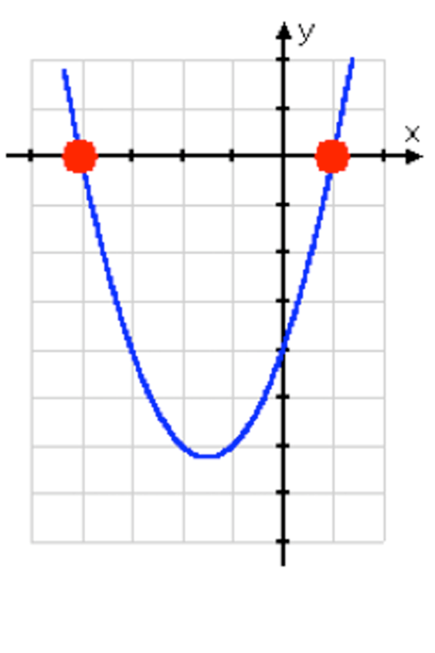
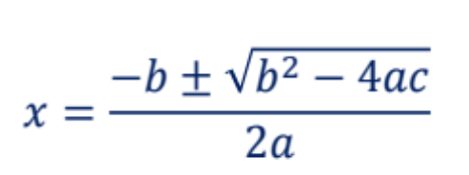
Intermediate Algebra – Quadratics
x² + 3x – 4 = y
x² + 3x – 4 = 0
Factoring:
(x – 1) (x + 4) = 0
X = 1, -4
For ax² + bx + c = 0, the value of x is given by:
X= (-3 + (3² – 4*1*-4)^{.5})/2 = 1
X= (-3 - (3² – 4*1*-4)^{.5})/2 = -4
Quadratic Formula

Slide 51
Intermediate Algebra – Factoring Polynomials, Solve for x
x² - 2x - 15 = 0
(x - 5) (x + 3) = 0
x = 5, -3

Slide 52
Intermediate Algebra – Factoring Polynomials
Example 1
Example 2
x³ + 3x² + 2x + 6
(x³ + 3x²) + (2x + 6)
x²(x + 3) + 2(x + 3)
(x + 3) (x² + 2)
x³ + 3x² + 2x + 6 / (x + 3)
((x³ + 3x²) + (2x + 6)) / (x+3)
(x²(x + 3) + 2(x + 3)) / (x+3)
((x + 3) (x² + 2)) / (x+3)
x² + 2

Slide 53
Intermediate Algebra – Exponents
x³ * x² = x⁵
x⁹ / x² = x⁷
(x²)⁵ = x¹⁰
1/x⁴ = x⁻⁴
x² * x^{.5} = ?
x⁴ / x⁸ = ?
(x^{.5})² = ?
1/x^{-z} = ?
x² * x^{.5} = x^{2.5}
x⁴ / x⁸ = x⁻⁴
(x^{.5})² = x
1/x^{-z} = x^{z}

Slide 54
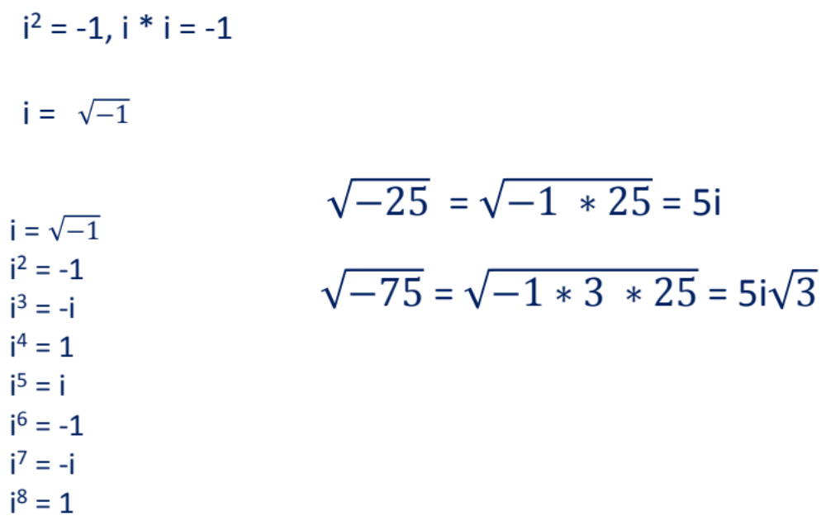
Intermediate Algebra – Imaginary Numbers

Slide 55
Coordinate Geometry – Coordinates Equation of a Line
y = mx + b, equation of a linear (straight) line
m = slope of the line = change in Y / change in X
b = y intercept
If m is negative, the line is going down and if positive the line is going up (left to right).
What is the equation for the line between points, (1, -2) & (6, 8)?
m = change in y values / change in x values = (y₁ – y₂) / (x₁ – x₂)
m = [8- (-2)] / (6 - 1) = 10/5 = 2
b = y – mx; b = 8 – (2) × (6) = 8 – 12 = -4
y = 2x -4

Slide 56
Coordinate Geometry – Coordinates
What is the distance between these points
(-1, 2) and (6, 8)?

Slide 57
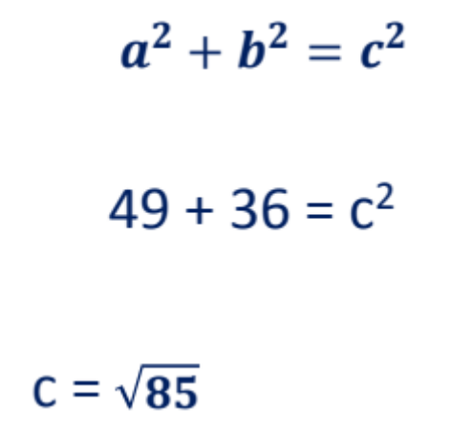
Coordinate Geometry – Coordinates
What is the distance between these (-1, 2) and (6, 8)?
* 6, 8
c
b
6
a
* -1, 2
7

Slide 58
Plane Geometry
Lines and Angles
Triangles
Circles
Squares and Rectangles
Multiple Figures

Slide 59
Plane Geometry: Lines
c
abc +
cbd = 180⁰
a
d
b
a
b
d
c
Opposite (vertical) angles are congruent (equal)
All angles combined = 360⁰
Transversal line thru two parallel lines creates equal opposite angles.

Slide 60
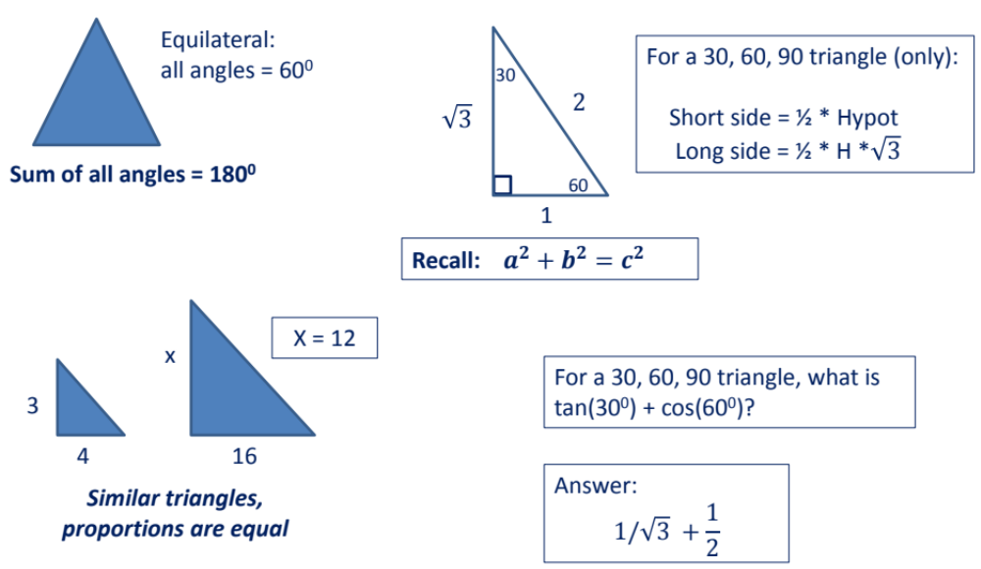
Plane Geometry: Triangles

Slide 61
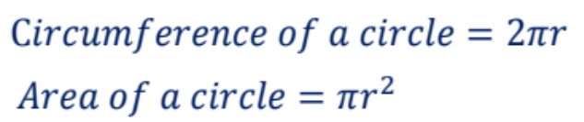
Plane Geometry
Area of a triangle = ½ (base * height) The sum of the three angles = 180⁰
Area of a trapezoid = ½ (a +b)*(height) where a and b are the lengths of the parallel sides
Diameter = 2 * radius of a circle
Volume of cylinder = area of circle * height
a
b
r
h

Slide 62
Plane Geometry Example
What is the area of the square if the radius equals 5?
L
L
r
Diameter = 2 x r
The diameter = 1 side of the square
Area = L x L
Diameter = 10 (same as a length of a side), Area = 100

Slide 63
Plane Geometry Parallelogram
Area = Base x Height
h
b
Note a rectangle is a parallelogram.
The sum of the angles = 360⁰

Slide 64
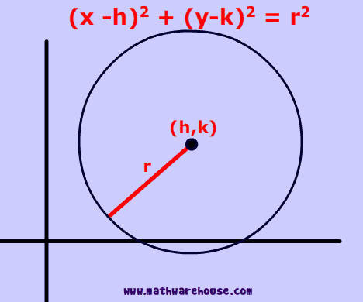
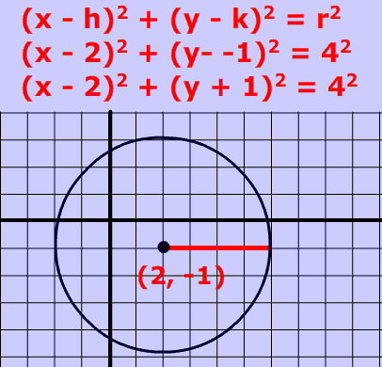
Plane Geometry Circles

Slide 65
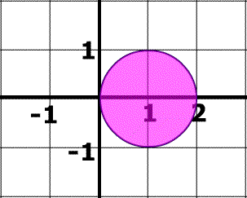
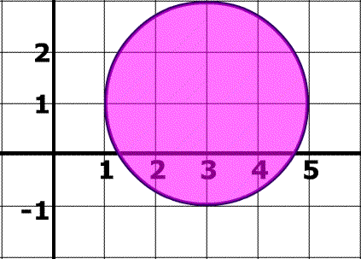
Plane Geometry Circles
What is the equation of these circles?
(x-1)² + y² = 1
(x-3)² + (y-1)² = 4

Slide 66
Plane Geometry Terms
Congruent = equal lengths
Co-linear = on same line
abc = the angle of b in the triangle abc
Acute = less than 90 degrees
(A cute little angle)
Obtuse = greater than 90 degrees

Slide 67
Trigonometry
For all right triangles
H
O
90°
Memory Aid
SOH CAH TOA
sin (t) = sine t =
cos (t) = cosine t =
tan (t) = tangent t =
cot (t) = cotangent t =
t
A
opposite side
O
=
=
=
=
hypotenuse
H
adjacent side
A
hypotenuse
H
opposite side
O
adjacent side
A
1
adjacent side
A
tangent t
opposite side
=
O

Slide 68
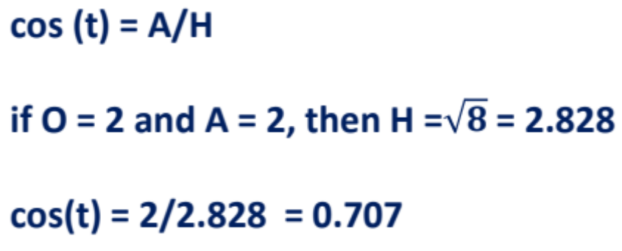
Trigonometry
H
O
t
A
H² = A² + O²

Slide 69
Trigonometry
Tan (t) = O/A
if O = 2 and A = 2, then O/A = 2/2 = 1
Tan (t) = 1
H
O
t
A
H² = A² + O²

Slide 70
Miscellaneous Topics – You May See These On The ACT Math
Fundamental Counting Principles
3 shirts, 2 pairs of pants, 4 sweaters – how many days with a different outfit?
(3)(2)(4) = 24 day of a unique combination
How many different and unique phone numbers of a 7 digit number?
(10)(10)(10)(10)(10)(10)(10) = 10⁷

Slide 71
Miscellaneous Topics – Probabilities – Examples
Given: 5 red marbles are placed in a bag along with 6 blue marbles and 9 white marbles:
Question: if three white marbles are removed, what is the probability the next marble removed will be white?
Originally, there were 9 white marbles out of 20; with 3 white marbles removed, there are 6 out of 17 remaining. The probability the next marble removed is white = 6/17.
Question: if 4 blue marbles are added to the original amount, what is the probability the first marble removed is NOT white?
Now there are 24 marbles total with 15 non-white. The probability that the first marble removed is not white is 15/24.

Slide 72
ACT Test Prep
Science

Slide 73
Science Section of the ACT
40 Questions in 35 Minutes
Goal: Answer 75% correctly (30 out of 40)
This means you need a strategy to confidently answer 30 questions correctly in 35 minutes.

Slide 74
Science Reasoning Vocabulary
2-butanone
2-propanol
µmho/cm
[theta]
absorbance
Alpha, alpha decay
amino acid
ammonium nitrate
asteroid
average molecular mass
beta
beta particles
biomass
biosphere
biotic index
bog
buoyancy
buoyant force
calcareous ooze
calcite
calcium carbonate
capacity
capillary
carbon dioxide
carbon particles
carbonate
Celsius
charged particles
chromatid
chromosome
climatic
colorimeter
comet
condensation
conductivity
continental drift
continental ice
sheet crater
crown fire
cytoplasm
°C
CaCl₂
CaCO
CaCo₃
Ch³
CuO
denature
density
depth range
derived
diffuse
directly proportional
drawn to scale
∆
δ
ecology
ecopark
ecosystem
efficiency
emit
equilibrium
equivalency
erosion
ethyl acetate
exclusion chromatography
extinct
extinction
Fahrenheit
failed burn
flask
formula
frequency
°F
ft/sec
gamma
gas chromatograph
genus
glacier
groundwater
habitat
helium
hexane
high-frequency
H₂
H₂O
Hg
ice shelf
ignite
index
infrared
inorganic
invertebrate
isotope
joule
kinetic
km
landmass
lava
lithium chloride
long-term
LiCl
mammal
manometer
mapping function
marine (adj)
Mass, massive
meiosis
mesopause
mesosphere
Methane, methanol
microscopy
migrating
migratory
Milli-bar
model
Mole, molecule
molecular weight
montane
mL, mm Hg, µ
nitrite
nitrogen-fixing
nonreactive
numerical aperture
nutrient
NaCl, NH₄NO₃
objective lens
organic matter
organism
osmosis
ozone
paleozoic
particle
parts per million
peat
peer (n)
permeable
photosynthetic
pinnate
plume
plunger
plutonium
polar
pollen
polymer
polyrhythm
polystyrene
pore water
precipitate (v)
projectile
prophase
pyrotechnics
radar pulse
radioactive decay
rallies (n)
range
reaction
reactive
recasting
recipient
relief supplies
renatured
retention time (RT)
Revitalize
rift
saturation

Slide 75
Science Reasoning Vocabulary
sea floor
sediment
seemingly
selective
semipermeable
sluggishly
sodium chloride
solar
solar system
solute (adj)
solutes
solution
Solvent
sparking device
species
specific
specific gravity
speculate
spent
sprawl
spurred
stagnant
standard atmospheric
pressure
standard sample
static
stratopause
stratosphere
sucrose
sulfate
supersaturated
suspension
synthesis
synthesize
SO₄
tactic
thermosphere
tolerance
toxic
tropopause
troposphere
ultraviolet
undersaturated
uninhibited
uranium series
vapor
vapor plume
variable
velocity
vertebrate
volcanic
volcanism
water table
watt
wetlands
zoning
Scientific notation
Students should recognize:
allele notation
binomial nomenclature
chemical equation
chemical formula
element symbol
isotope

